Slide 1
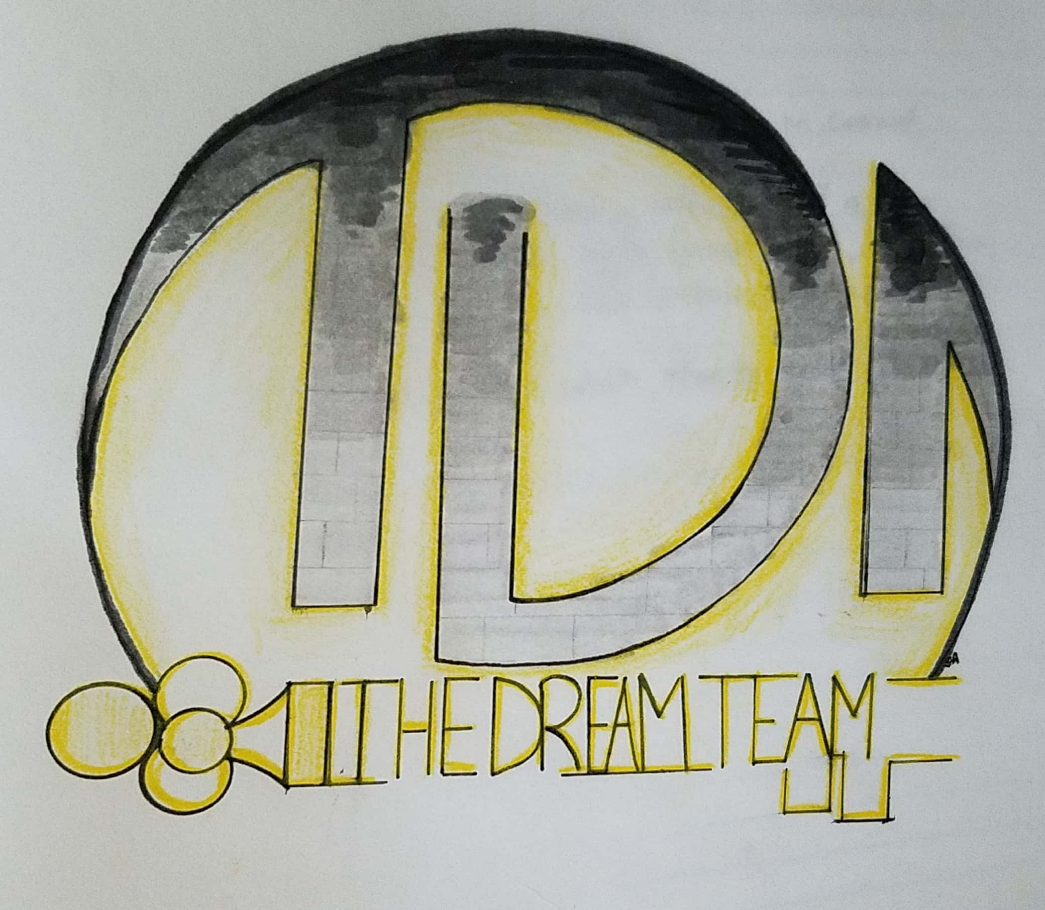
Dream Team
Chasing the End

Slide 2
Chasing the End
Single player
Top down
Adventure/Puzzle
Retro and Nostalgic
Laid-back and forgiving

Slide 3
Audience and Uses
Audience
Beginning to experienced game players
Uses
Single player experience
Enjoyable and laid-back experience
Nostalgic gaming experience
Casual adventure/puzzle experience

Slide 4
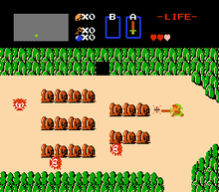
The Legend of Zelda (1986)
Action/Adventure game developed by Nintendo
Top down perspective
Focus on discovery and collection
Labyrinthine Environment
Forces combat
Unforgiving

Slide 5
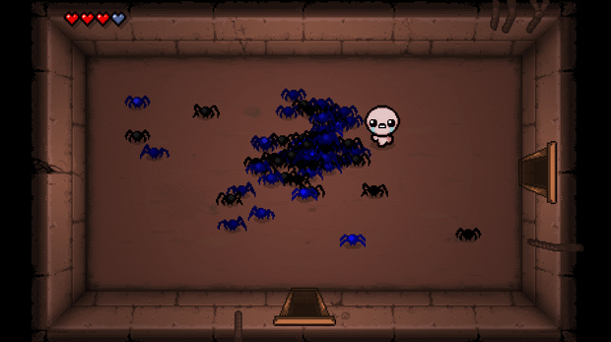
The Binding of Isaac (2011)
Single player, Roguelike
Top down perspective
Objective based maze-like levels
Forces combat
Unforgiving and stressful

Slide 6
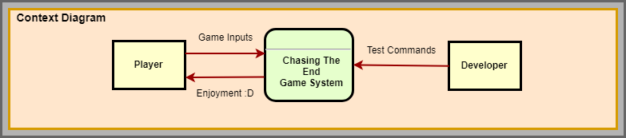
Context Diagram

Slide 7
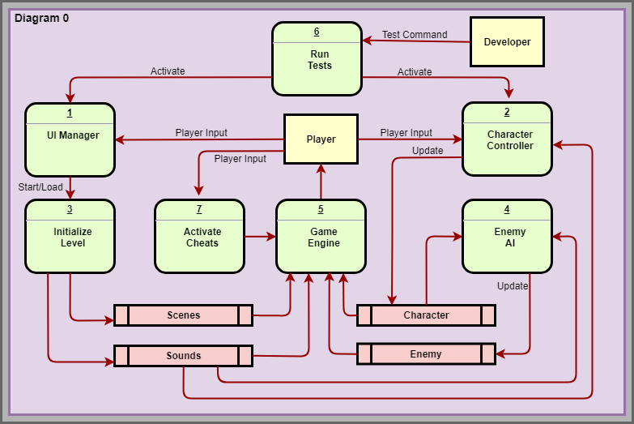
Data Flow Diagram

Slide 8
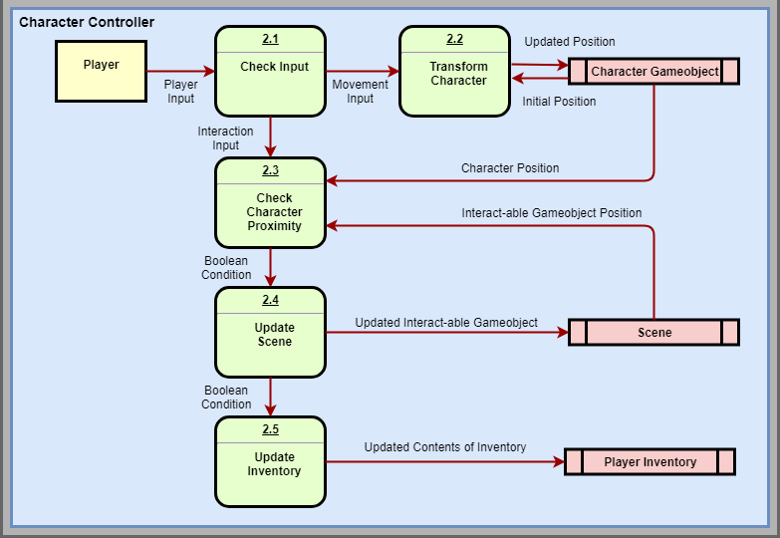
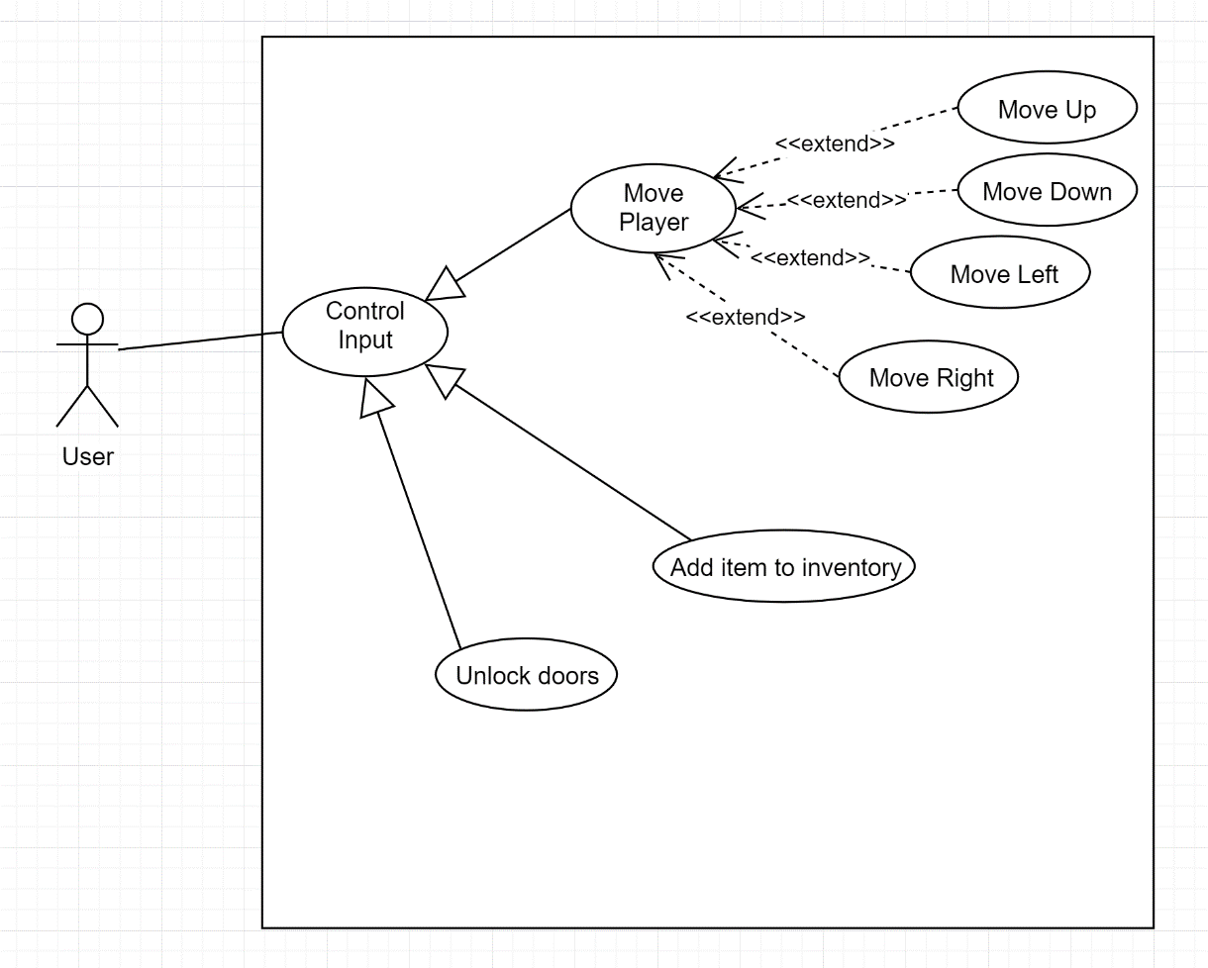
Player Design (Brad)

Slide 9
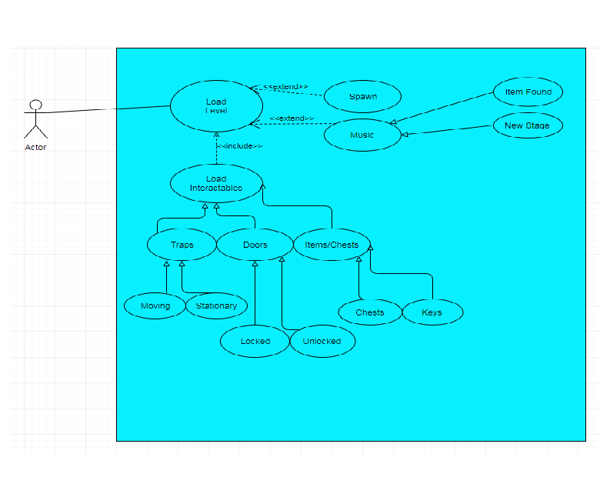
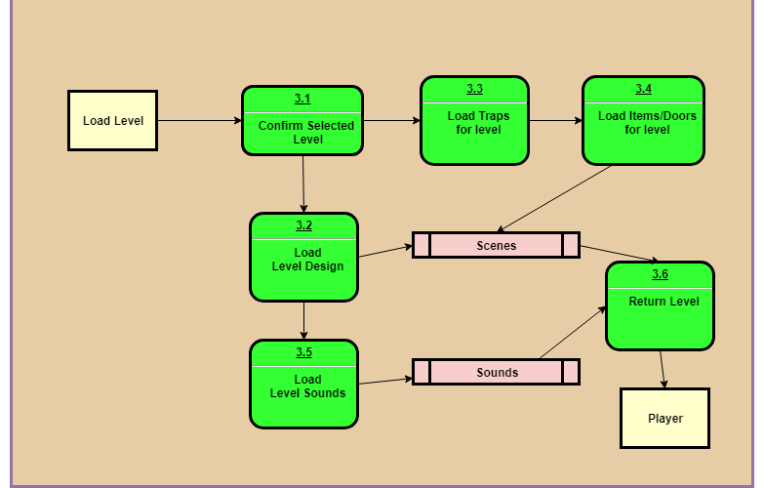
Level Design (Tyler)

Slide 10
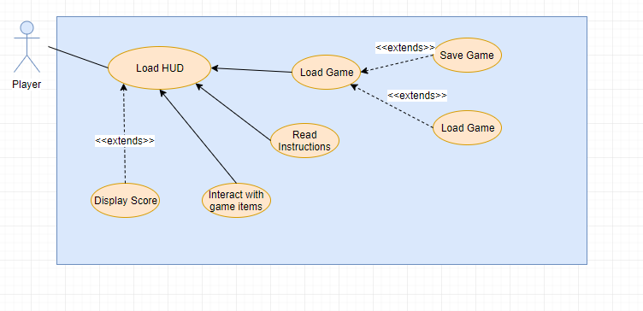
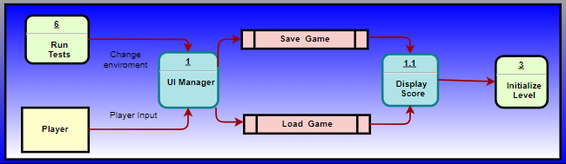
HUD/UI (Jorge)

Slide 11
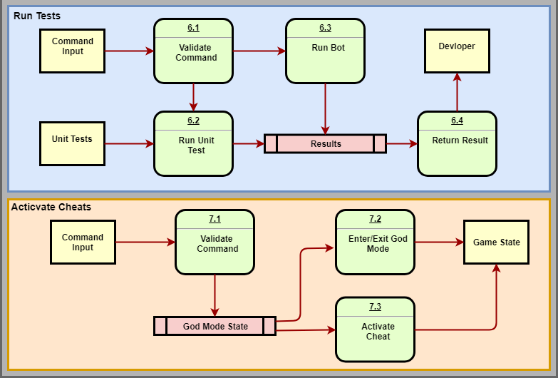
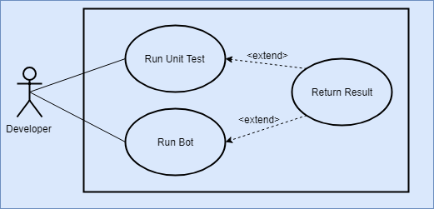
Testing/Cheats (Luke)

Slide 12
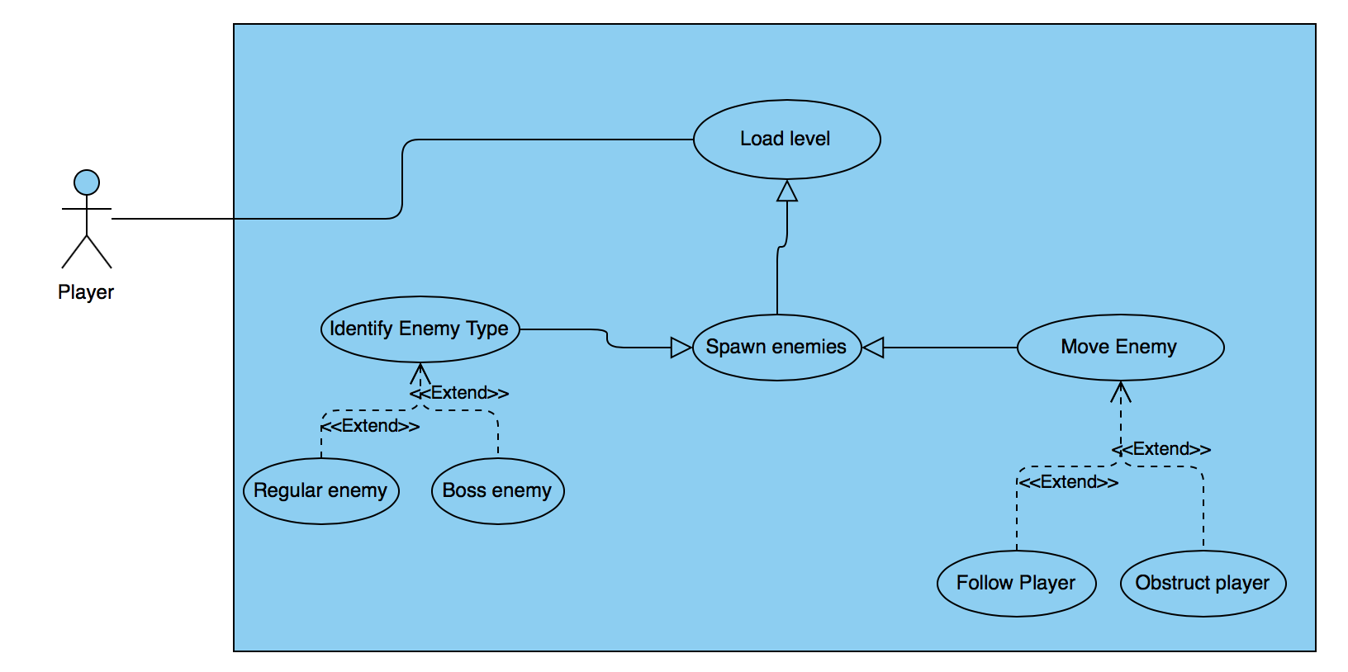
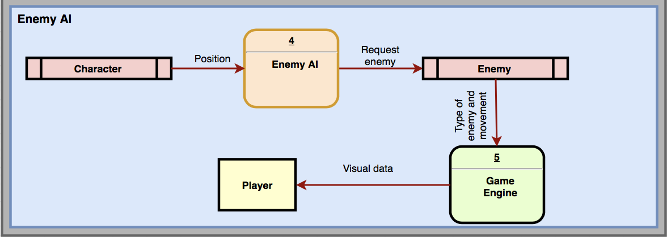
Enemy AI (Edgar)

Slide 13
Any Questions?

